Slide 1
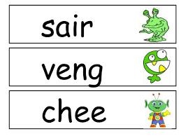
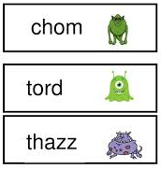
Phonics Screening Check
Information for Parents/Carers

Slide 2
What is Phonics?
Using phonics is a way of teaching children to read quickly and skilfully. Children are taught how to recognise sounds that each individual letter makes and also to identify the sounds that different combinations of letters make such as ‘sh’ and ‘oo’.
Children are taught to read by breaking down words into separate sounds or ‘phonemes’. They are then taught how to blend these sounds together to read the whole word.

Slide 3
Why Phonics?
Research shows that when phonics is taught in a structured way, starting with the easiest sounds and progressing through to more complex sounds, it is the most effective way of teaching children to read.
Almost all children who receive good teaching of phonics will learn the skills they need to tackle new words. They can then go onto read any kind of text fluently and confidently and for enjoyment.

Slide 4
What is the phonics screening check?
The National phonics screening check is a statutory assessment that was introduced in 2012 to all Year 1 pupils. It is a quick check of your child's phonics knowledge and their skills in applying that knowledge.

Slide 5
Who is it for?
All year 1 pupils, and some year 2 pupils, will take the phonics screening check in 2024 during the week beginning 10th June.

Slide 6
What is in the phonics screening check?
It comprises of a list of 40 words, some real and some nonsense words (also known as Pseudo words). It will assess the phonics skills and knowledge your child was taught in Reception and Year 1. Your child will read one‐to-one with a teacher. (Either Mrs Heys or Miss Hughes)
Your child will read up to 4 words per page and they will probably do the check in about 10‐15 minutes.
They will be asked to ‘sound out’ a word and blend the sounds together. The check is very similar to tasks the children already complete during phonics lessons.

Slide 7
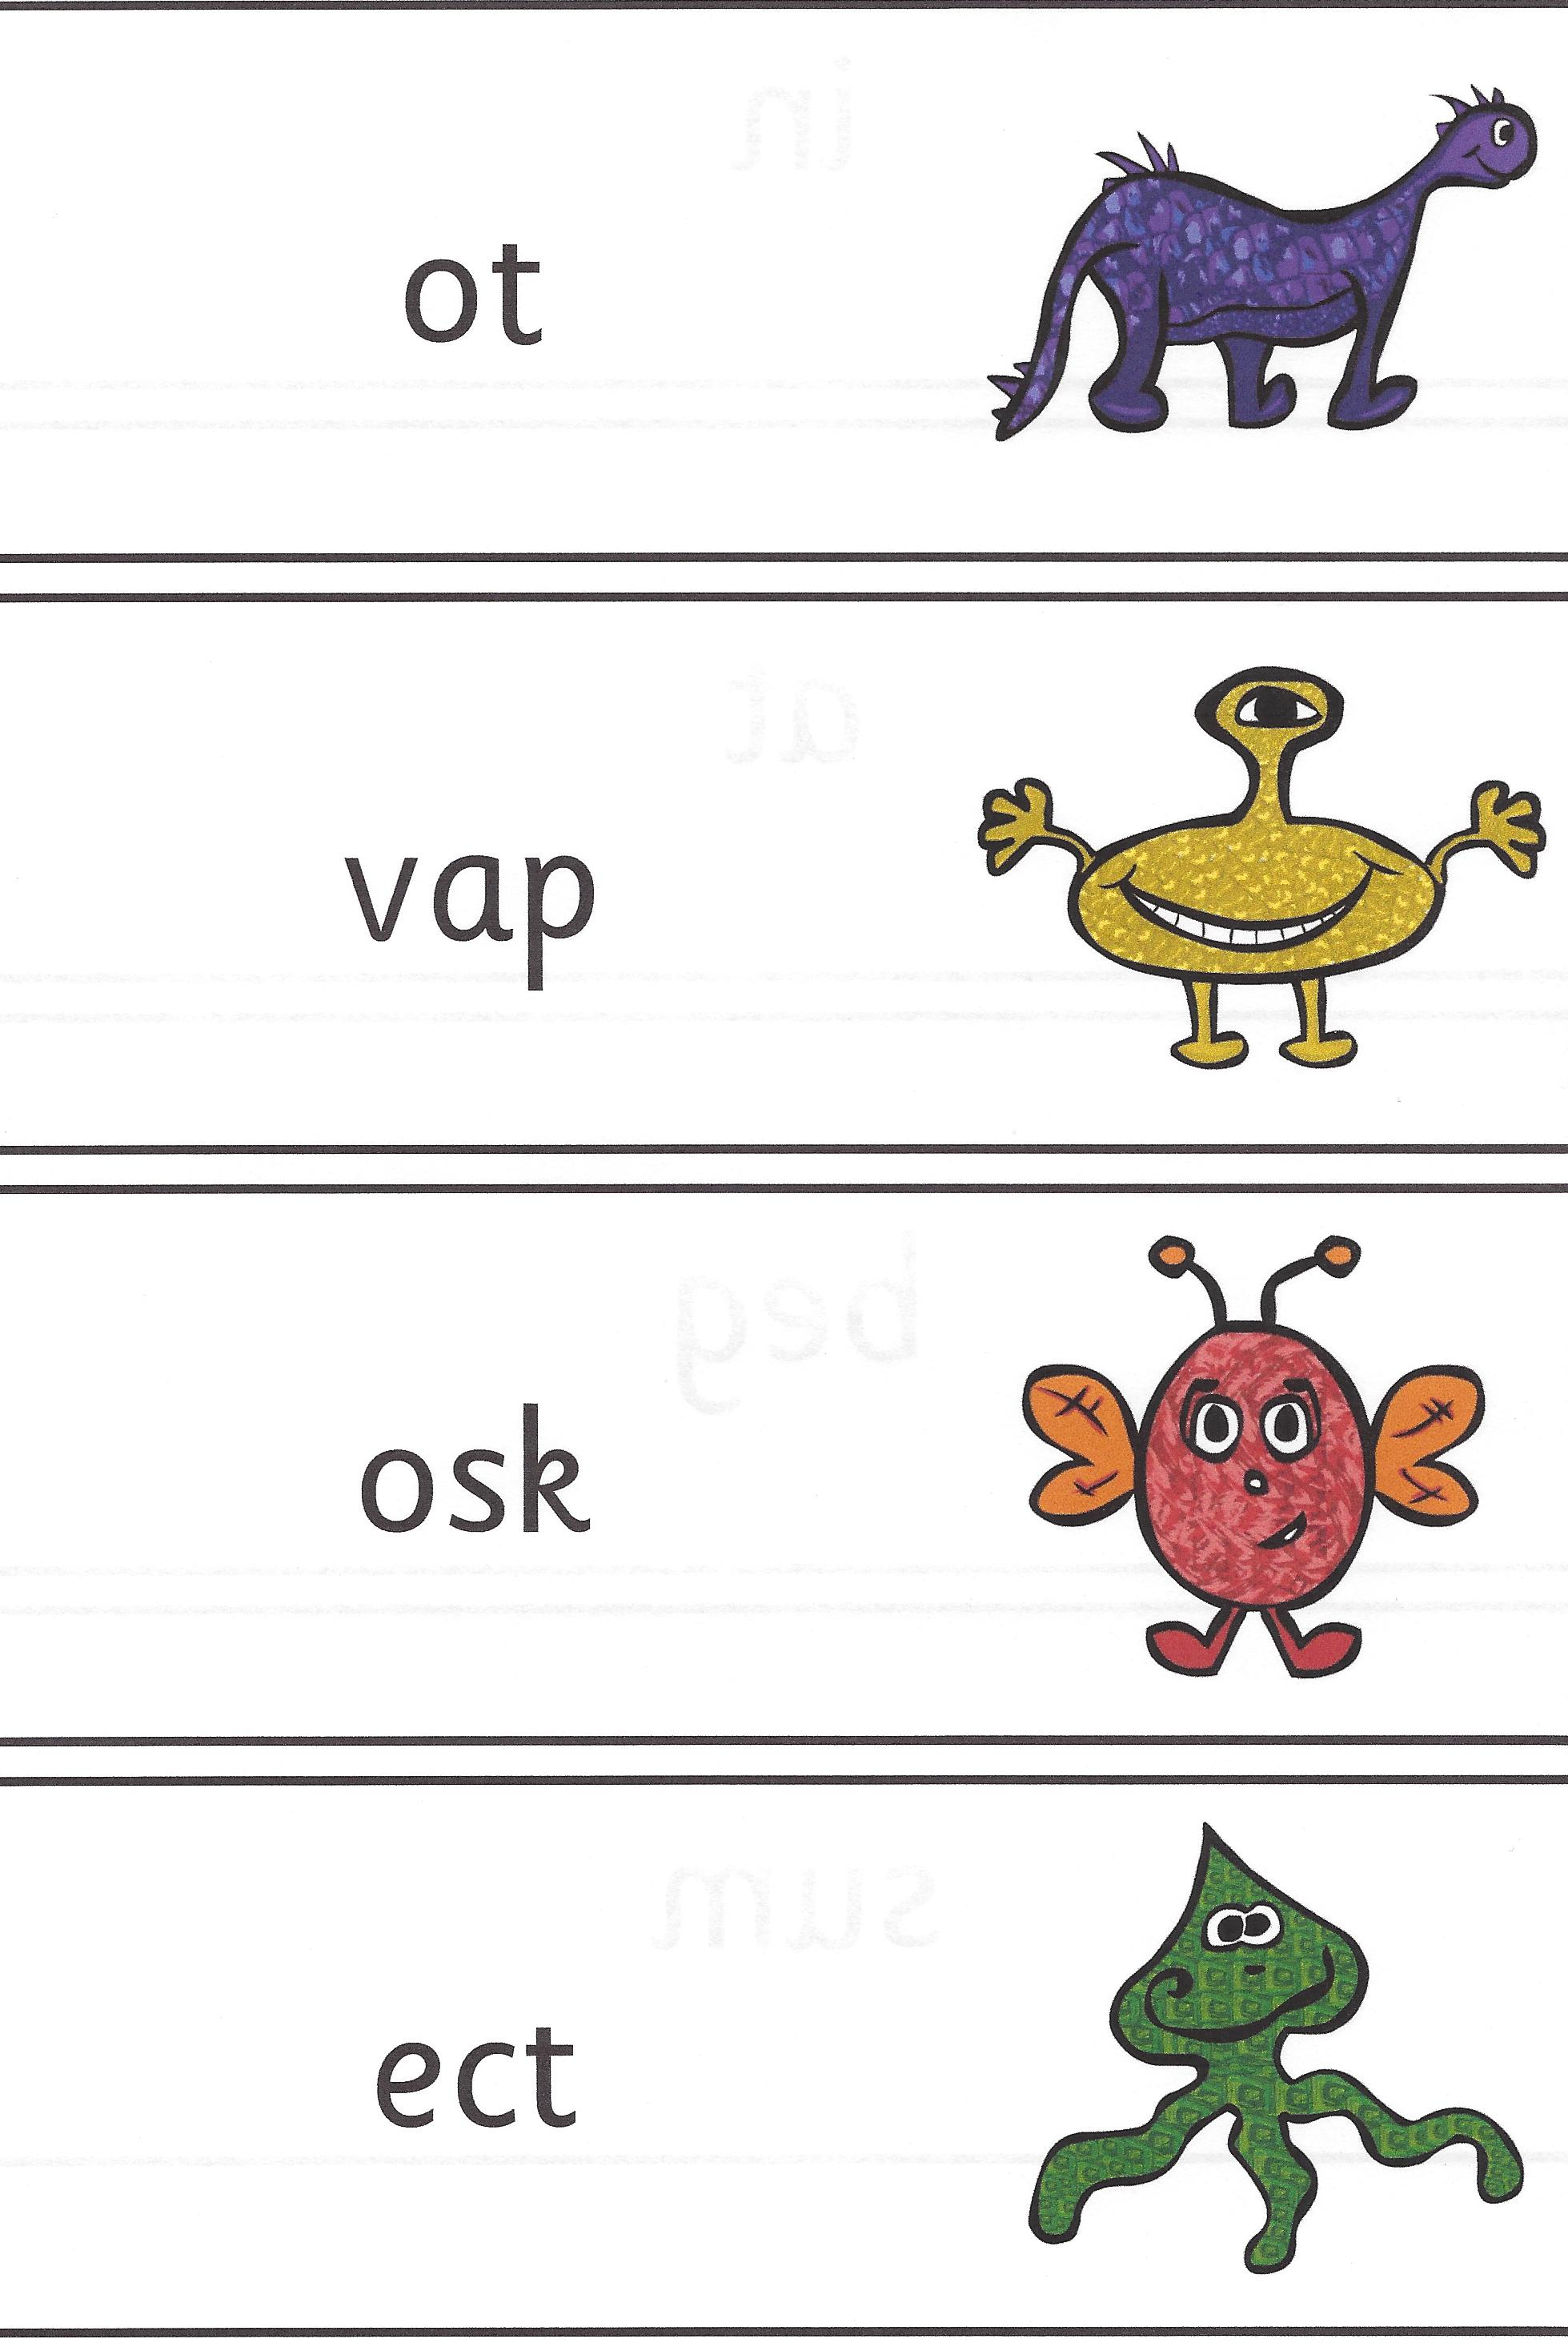
What are pseudo words and why are they included?
These are words that are phonetically decodable but don’t make sense e.g. brip, snorb. These words are included in the check specifically to assess whether you child can decode a word using phonic skills and not their memory – by remembering whole words.
The pseudo (nonsense) words will be shown to your child with a picture of an alien. The children will be asked what the aliens name is by reading the word. This will make the check a bit more fun and provides the children with a context for the nonsense word.
Crucially it does not provide any clues, so your child has to be able to decode it. Children generally find nonsense amusing so they will probably enjoy reading these words.

Slide 8
Here is are a couple of clips from the government training video that all teachers must watch before administrating the test.
It will give you an idea of the test and what we are allowed to accept as answers.
https://www.gov.uk/government/publications/phonics-screening-check-sample-materials-and-training-video
Notes:
1.07-2.24 4.08 – 4.56

Slide 9
How will the results from the screening be used?
You will be informed of your child’s progress in phonics and how he or she has done in the screening check, towards the end of the summer term.
The screening check ensures that teachers understand which children need support with decoding.
If your child’s score falls below the national standard they will re-take the Phonics Screening Check in year 2.
Notes:
Since the test was introduced in 2012 the pass mark has been 32 out of 40. The government doesn’t tell us what the pass mark is until we have submitted the results. Due to the higher demands of the curriculum, the pass mark may go up.

Slide 10
How can you help your child?
There are a number of things that parents can do to support early reading development:
Let your child see you enjoy reading yourself. They are influenced by you and what you do!
Immerse your child in a love of reading.
Make time for your child to read their school book to you every day.
With all books, encourage your child to ‘sound out’ unfamiliar words and then blend from left to right.
Please do the Nonsense Nan work every day.

Slide 11
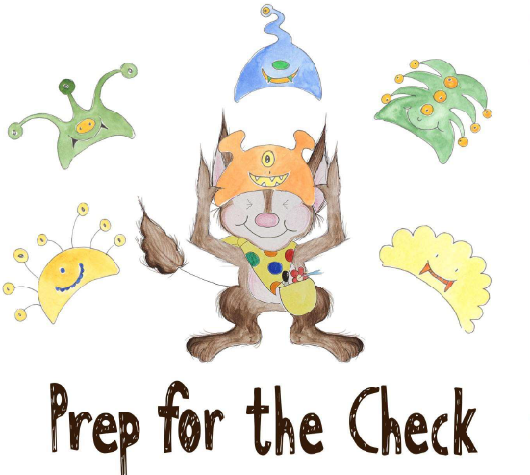
Nonsense Nan
In school we use the scheme Super Sonic Phonics to teach phonics.
On the school website (under Year 1) there are lots of practise papers for the screening check for you to do at home with your child.
You don’t need to print anything off – just open
up the link and have a go at reading the words.
https://heatonparkprimary.co.uk/year-groups/year-1/

Slide 12
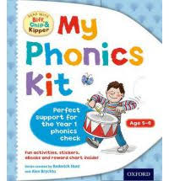
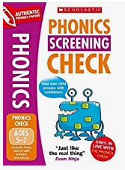
Resources you can use at home:
WEBSITES
www.phonicsplay.co.uk (14 day free trial available or £6 for 1 year)
http://www.letters-and-sounds.com/ (Free printable resources)
https://home.oxfordowl.co.uk/preparing-for-the-phonics-screening-check/ (Lots of information)
BOOKS
My phonics kit (Oxford Reading Tree, £6.49 Amazon)
Phonics Screening Check (Scholastic, Amazon £6.99)

